Slide 1
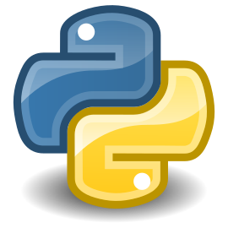
Introduction to Programming in Python Version Control Sytems
dr inż. Barbara Fryc

Slide 2
What is a Version Control System (VCS) ?
A system that keeps records of your changes
Allows for collaborative development
Allows you to know who made what changes and when
Allows you to revert any changes and go back to a previous state

Slide 3

Local Version Control Systems

Slide 4
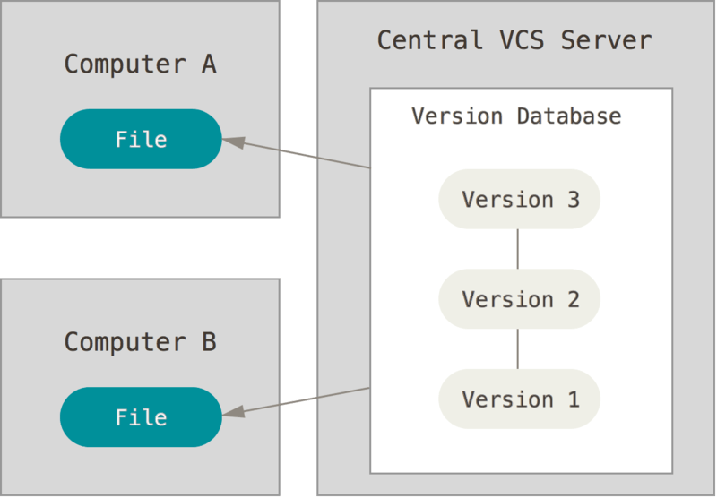
Centralized Version Control Systems

Slide 5
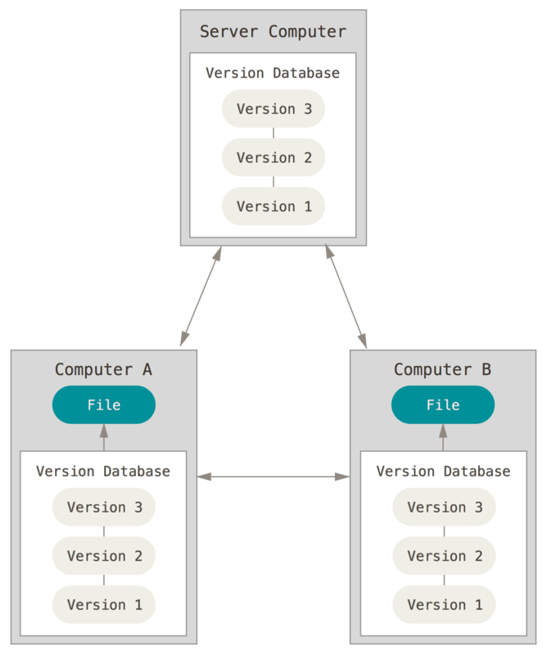
Distributed Version Control Systems

Slide 6

What is Git?
Free, open source
Fully distributed
Handle small files very effectively
Tracks contents, not files
Data = Snapshot
No network
Three stages

Slide 7
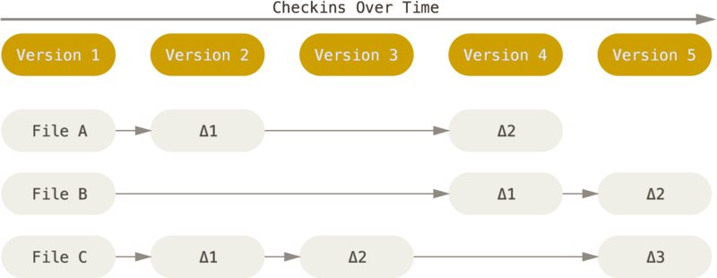
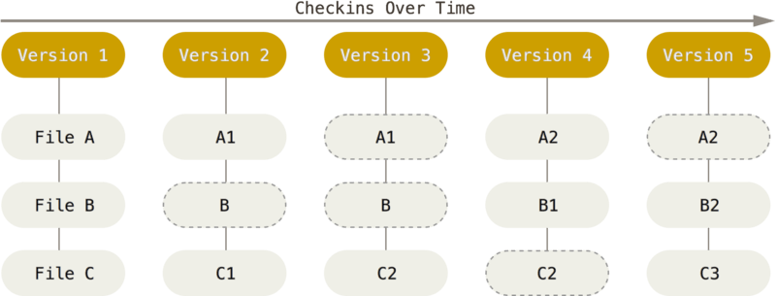
Storing data
The major difference between Git and any other VCS (Subversion and friends included) is the way Git thinks about its data. Conceptually, most other systems store information as a list of file-based changes.
Storing data as changes to a base version of each file
Storing data as snapshots of the project over time

Slide 8
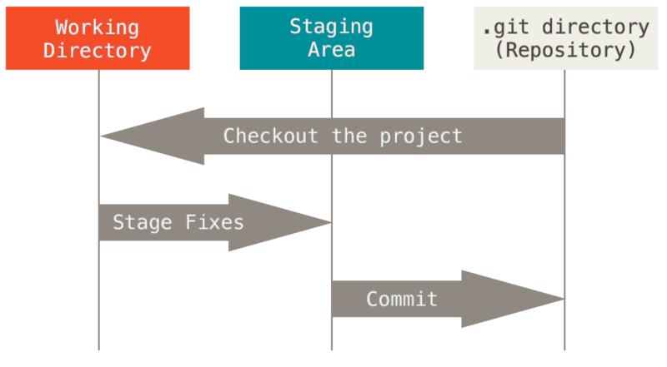
The Three States
Git has three main states that your files can reside in: modified, staged, and committed:
Modified means that you have changed the file but have not committed it to your database yet.
Staged means that you have marked a modified file in its current version to go into your next commit snapshot.
Committed means that the data is safely stored in your local database.

Slide 9
The Three States
The basic Git workflow goes something like this:
You modify files in your working tree.
You selectively stage just those changes you want to be part of your next commit, which adds only those changes to the staging area.
You do a commit, which takes the files as they are in the staging area and stores that snapshot permanently to your Git directory.
If a particular version of a file is in the Git directory, it’s considered committed. If it has been modified and was added to the staging area, it is staged. And if it was changed since it was checked out but has not been staged, it is modified. In Git Basics, you’ll learn more about these states and how you can either take advantage of them or skip the staged part entirely.

Slide 10
Install git
Windows
○ http://git-scm.com/download/win
Linux (Debian)
○ Command: sudo apt-get install git
Linux (Fedora)
○ Command: sudo yum install git
Mac
○ http://git-scm.com/download/mac

Slide 11
GIT COMMANDS CHEAT SHEET
Set configuration values for your username and email
git config --global user.name YOUR NAME
git config --global user.email YOUR EMAIL
Set default branch to main
git config --global init.default branch main
Get help on a command
git help COMMAND
git COMMAND -h
Notes:
Check the unstaged changes git diff Commit the staged changes git commit -m "MESSAGE" Reset staging area to the last commit git reset Check the state of the working directory and the staging area git status Remove a file from the index and working directory git rm FILENAME Rename a file git mv (OLD NAME) (NEW NAME) List the commit history git log List all the local branches git branch Create a new branch git branch BRANCH NAME Rename the current branch git branch -m NEW BRANCH NAME Delete a branch git branch -d BRANCH NAME Switch to another branch git switch BRANCH NAME Merge specified branch into the current branch git merge BRANCH NAME Create a connection to a remote repository git remote add (NAME) (REPOSITORY URL) Push the committed changes to a remote directory git push (REMOTE) (BRANCH) Download the content from a remote repository git pull REMOTE
https://www.youtube.com/watch?v=tRZGeaHPoaw

Slide 12
GIT COMMANDS CHEAT SHEET
Initialize a new git repository
git init
Clone a repository
git clone REPOSITORY URL
Add a file to the staging area
git add FILE
Add all file changes to the staging area
git add –all
git add –A
git add .
Notes:
Check the unstaged changes git diff Commit the staged changes git commit -m "MESSAGE" Reset staging area to the last commit git reset Check the state of the working directory and the staging area git status Remove a file from the index and working directory git rm FILENAME Rename a file git mv (OLD NAME) (NEW NAME) List the commit history git log List all the local branches git branch Create a new branch git branch BRANCH NAME Rename the current branch git branch -m NEW BRANCH NAME Delete a branch git branch -d BRANCH NAME Switch to another branch git switch BRANCH NAME Merge specified branch into the current branch git merge BRANCH NAME Create a connection to a remote repository git remote add (NAME) (REPOSITORY URL) Push the committed changes to a remote directory git push (REMOTE) (BRANCH) Download the content from a remote repository git pull REMOTE
https://www.youtube.com/watch?v=tRZGeaHPoaw

Slide 13
GIT COMMANDS CHEAT SHEET
Check the unstaged changes
git diff
Commit the staged changes
git commit -m "MESSAGE"
Reset staging area to the last commit
git reset
Check the state of the working directory and the staging area
git status
Remove a file from the index and working directory
git rm FILENAME
Rename a file
git mv (OLD NAME) (NEW NAME)

Slide 14
GIT COMMANDS CHEAT SHEET
List the commit history
git log
List all the local branches
git branch
Create a new branch
git branch BRANCH NAME
Rename the current branch
git branch -m NEW BRANCH NAME
Delete a branch
git branch -d BRANCH NAME
Switch to another branch
git switch BRANCH NAME

Slide 15
GIT COMMANDS CHEAT SHEET
Merge specified branch into the current branch
git merge BRANCH NAME
Create a connection to a remote repository
git remote add (NAME) (REPOSITORY URL)
Push the committed changes to a remote directory
git push (REMOTE) (BRANCH)
Download the content from a remote repository
git pull REMOTE

